Slide 1
FlowFence: A Denial of Service Defense System for Software Defined Networking
Author: Piedrahita AFM, Rueda S, Mattos DMF, Duarte OCMB
Publisher/Conference: Global information infrastructure symposium (GIIS’2015)
Presenter: Cheng-Feng Ke
Date: 2017/05/24
Department of Computer Science and Information Engineering
National Cheng Kung University, Taiwan R.O.C.
Notes:
1

Slide 2
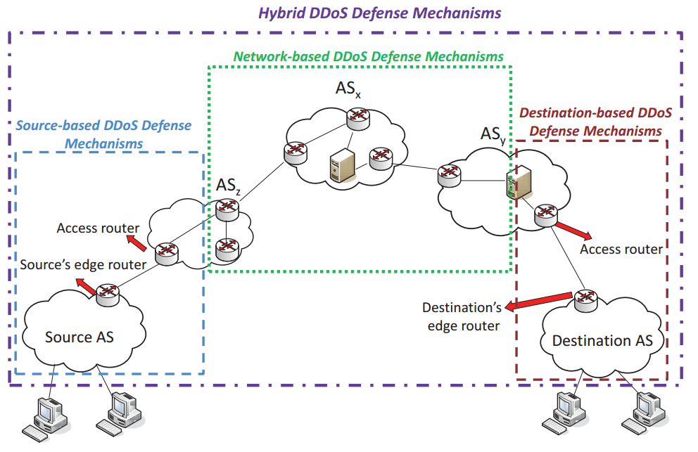
Introduction
These mechanisms can take place either at the edge routers of the source’s local network or at the access routers of an Autonomous System (AS) that connects to the sources’ edge routers
Notes:
優點是可以在浪費資源前就阻止攻擊。
缺點是如果是 DDOS ，attacker 會分散，很難辨認。

Slide 3
Introduction
In the destination-based defense mechanisms, detection and response is mostly done at the destination of the attack. Nevertheless, the use of defenses at the destination does not avoid network resource consumption.
Notes:
建立在 destination 附近。

Slide 4
Introduction
(ex: TRACK mechanism)
The hybrid mechanisms, however, work in a distributed way, which could be slow for critical applications, or could require additional headers in the network packets, degrading network performance.
Response
Detection
Notes:
Most of the destination-based mechanisms cannot accurately detect and respond to the attack before it reaches the victims and wastes resources on the paths to the victims; hence, they are not capable of detecting and responding to the DDoS attack traffic properly. Therefore, network-based DDoS defense mechanisms have been proposed to address this problem and to help both source and destination based mechanisms to carry out their duties more accurately.

Slide 5
Introduction
FlowFence
It does not focus on identifying who is the DoS attacker and not mark packets. (Compare to Source-based DoS defense)
Notes:
不用辨認攻擊者是誰

Slide 6
Introduction
FlowFence
It does not focus on identifying who is the DoS attacker and not mark packets. (Compare to Source-based DoS defense)
It does not force the routers to perform processing operations on each incoming packet to avoids processing overhead.
(Compare to Hybrid DoS defense, ex: TRACK mechanism)
Notes:
不會在 header 增加訊息，不用額外處理。

Slide 7
Introduction
FlowFence
It does not focus on identifying who is the DoS attacker and not mark packets. (Compare to Source-based DoS defense)
It does not force the routers to perform processing operations on each incoming packet to avoids processing overhead.
(Compare to Hybrid DoS defense, ex: TRACK mechanism)
FlowFence applies a progressively stronger bandwidth control over the flows.
Notes:
對抗 dos 的主要方法是控制 flow 的 bandwidth。

Slide 8
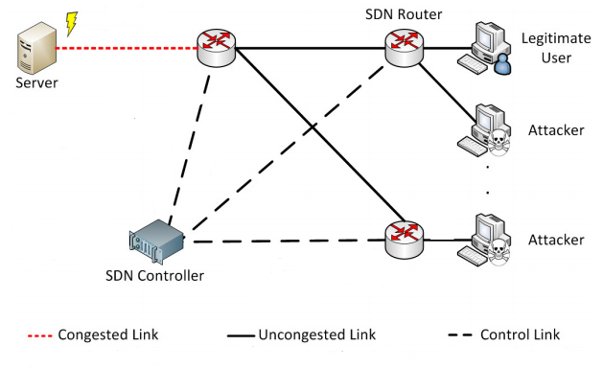
ARCHITECTURE
FlowFence
Notes:
架構

Slide 9
ARCHITECTURE
All the experiments were performed in the Future Internet Testbed with Security (FITS),
FITS is a testbed based on the Xen hypervisor and on the OpenFlow switching.

Slide 10
ARCHITECTURE
We use the MAGI(?) framework to create a highly controllable and replicable experiments in testbed environments.

Slide 11
ARCHITECTURE

Slide 12
ARCHITECTURE
SDN Router
Openflow protocol
Open vSwitch
Proactive rule (supposition)
Python application
(monitor、control、 communication)

Slide 13
ARCHITECTURE
SDN Controller
POX Controller
SDN application
(Calculating Flows Bandwidth)
(Northbound interface (supposition))

Slide 14
ARCHITECTURE
Python application
Monitors interface usage
Handles communication with the SDN controller.
Applies bandwidth control. (Open vSwitch Api)

Slide 15
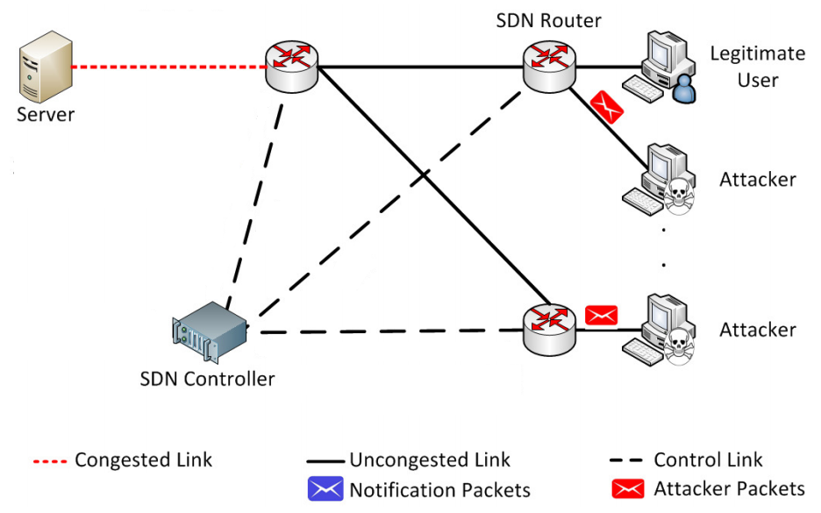
ARCHITECTURE
Defense Procedure

Slide 16
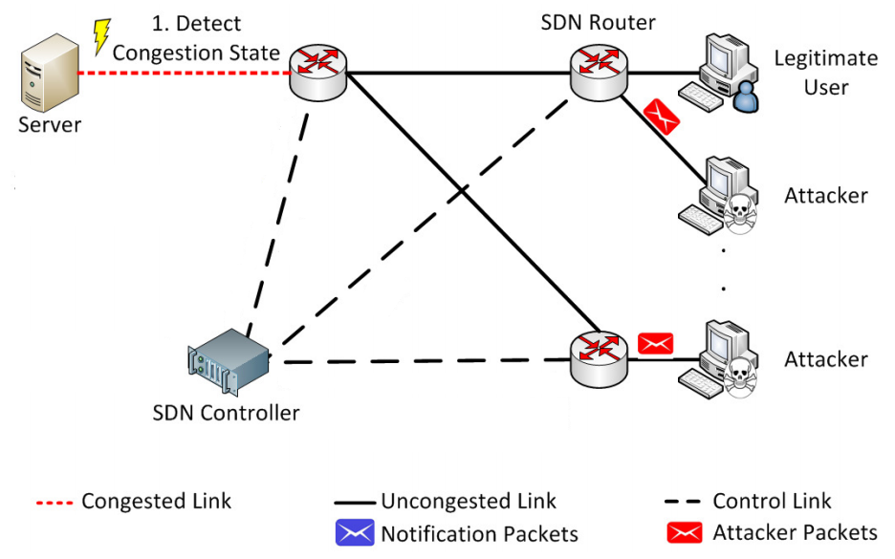
ARCHITECTURE
Defense Procedure

Slide 17
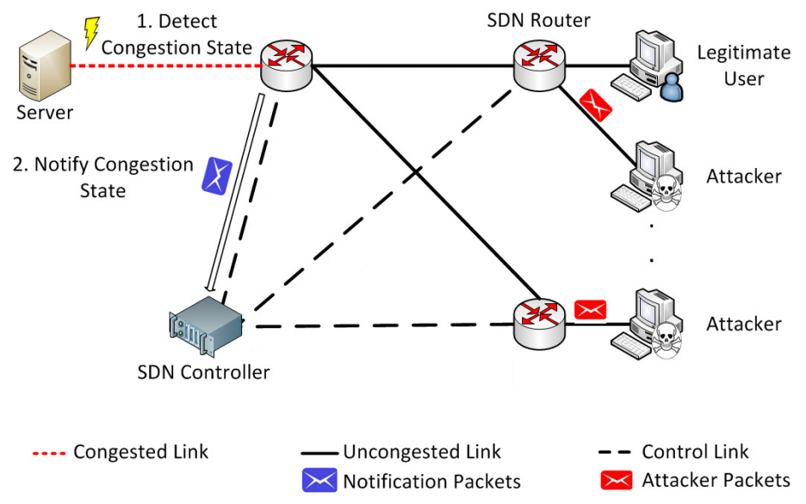
ARCHITECTURE
Defense Procedure

Slide 18
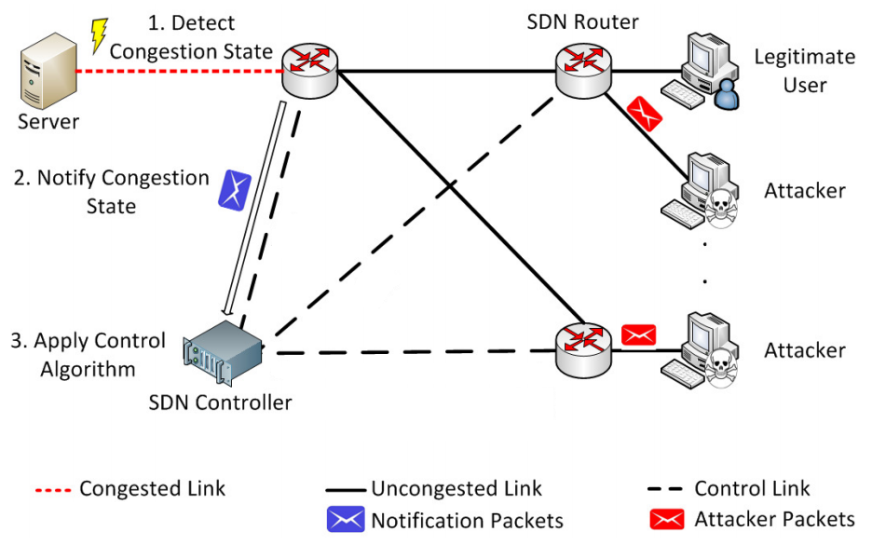
ARCHITECTURE
Defense Procedure

Slide 19
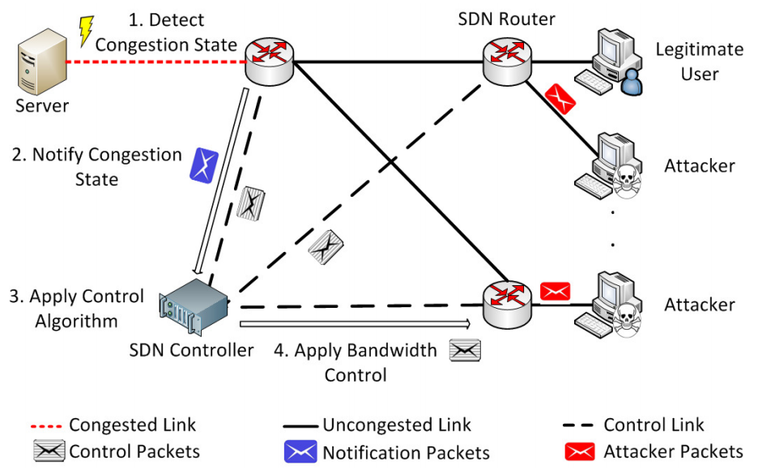
ARCHITECTURE
Defense Procedure (origin)
Notes:
原圖畫法

Slide 20
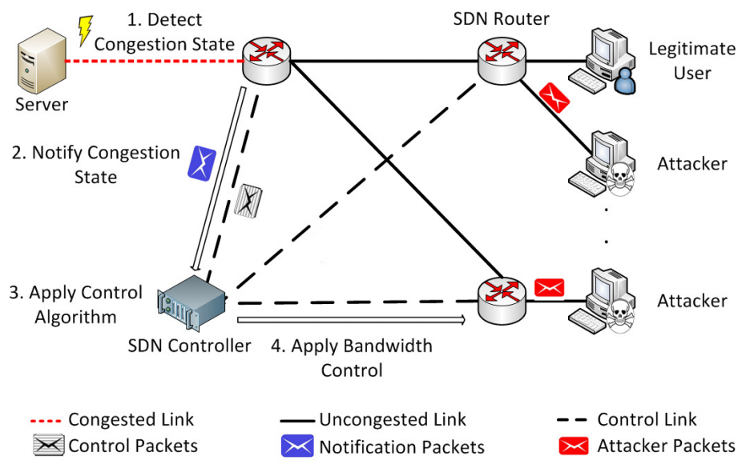
ARCHITECTURE
Defense Procedure (supposition)
The controller receives congestion notifications and flows statistics, and sends commands to the congested routers to control bandwidth usage of their flows. (*maybe non-OpenFlow)

Slide 21
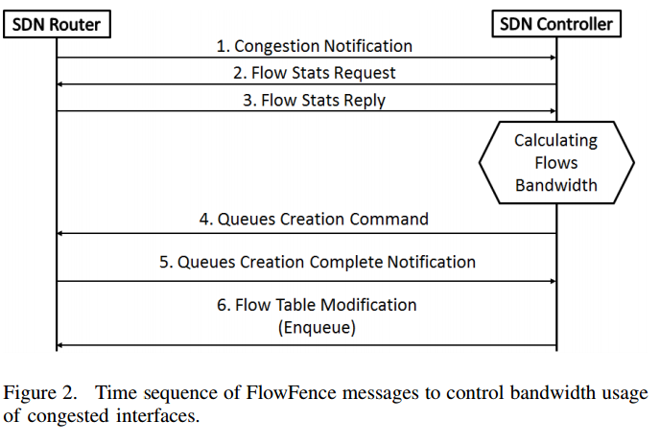
ARCHITECTURE
Python application

Slide 22
ARCHITECTURE
Python application
Openflow

Slide 23
ARCHITECTURE
Python application
Openflow
Open vSwitch

Slide 24
ARCHITECTURE
Python application
Openflow
Open vSwitch
?

Slide 25
ARCHITECTURE
(Architecture)
Open vSwitch supports the OpenFlow protocol and provides mechanisms for queue management and bandwidth control. (p.4)

Slide 26
ARCHITECTURE
(Architecture)
Open vSwitch supports the OpenFlow protocol and provides mechanisms for queue management and bandwidth control. (p.4)
(SDN application algorithm)
Once flows have been classified, the controller sends to the router a command to create one queue for each classified flow, and assigns independent bandwidths to each queue, as bandwidth control is applied through queues. (p.4)

Slide 27
ARCHITECTURE
(Architecture)
Open vSwitch supports the OpenFlow protocol and provides mechanisms for queue management and bandwidth control. (p.4)
(SDN application algorithm)
Once flows have been classified, the controller sends to the router a command to create one queue for each classified flow, and assigns independent bandwidths to each queue, as bandwidth control is applied through queues. (p.4)
(wikipedia) Active queue management
Drop-tail queues have a tendency to penalise bursty flows.

Slide 28
ARCHITECTURE
Python application
Openflow
Open vSwitch
Open vSwitch
Notes:
Queue and modification

Slide 29
ARCHITECTURE
Python application
Openflow
Open vSwitch
Open vSwitch
Notes:
Queue and modification

Slide 30
ARCHITECTURE
Openflow?
(Architecture)
Figure 2 shows the message exchange between an SDN router and the controller to perform bandwidth control. All the messages travel over a secure channel, as the OpenFlow protocol specifies. (p.3)
The SDN controller keeps secure connections with the routers using the control plane interfaces. (p.3)

Slide 31
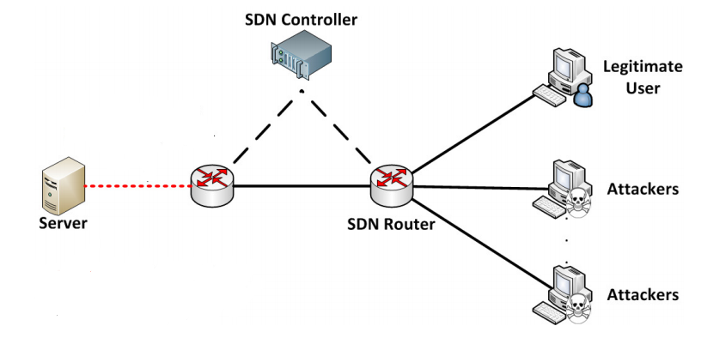
SDN application algorithm
Calculating Flows Bandwidth
Flow1 = 20
Flow2 = 40
Bandwidth = 100
Threshold = bandwidth / flowsSize
= 100 / 3 = 33.3
Flow3 = 40

Slide 32
SDN application algorithm
Bandwidth = 100
Threshold = 33.3
Once flows have been classified, the controller sends to the router a command to create one queue for each classified flow
Flow1 = 20
Flow2 = 40
Queue 1 = flow1 (Well-behaved flows)
Queue 2 = flow2 (Badly behaved flows)
Queue 3 = flow3 (Badly behaved flows)
Flow3 = 40

Slide 33

SDN application algorithm
First, it assigns bandwidth to well behaved flows.
Bandwidth of queue of well-behaved flows
=>
Bandwidth
Flow 1 (20) | 80

Slide 34
SDN application algorithm
Second, it assigns bandwidth to flows classified as badly behaved, which are penalized proportionally to their excess.
Bandwidth of queue of badly behaved flows
=>
Bandwidth
Flow 1 (20) | Flow 2 (40) | Flow 3 (40)

Slide 35
SDN application algorithm
Second, it assigns bandwidth to flows classified as badly behaved, which are penalized proportionally to their excess.
Bandwidth of queue of badly behaved flows
=>
( 1 - e^(33 - 40)) * 1 * 40 = 39.9635247
40 - 39.9635247 = 0.0364753
Bandwidth
Flow 1 (20) | Flow 2 (0.0364753) | Flow 3 (0.0364753) | 79.9270494

Slide 36

SDN application algorithm
Finally, it distributes remaining bandwidth among all the well behaved flows.
Bandwidth of queue of well-behaved flows
=>
20 + (79.9270494 / 1) = 99.9270494
Bandwidth
Flow 1 (99.9270494) | Flow 2 (0.0364753) | Flow 3 (0.0364753)

Slide 37
EXPERIMENTS
We assigned a capacity of 50 Mb/s to the shared link.
Legitimate and malicious clients are competing for the shared link to the server.
Two physical servers host the virtual machines and were connected using Gigabit Ethernet links.
Each server is equipped with two Intel(R) Xeon(R) CPU X5690 3.47 GHz and 48 GB of RAM, and runs Debian Linux 3.2.0-4-amd64.
Virtual machines were configured with a virtual CPU using one core, 256 MB of RAM, and running Debian Linux 3.2.0- 4-amd64.

Slide 38
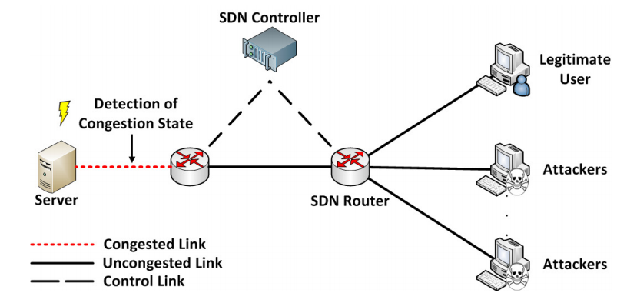
EXPERIMENTS
A dumbbell topology was selected because it is the worst case scenario for the DoS defense provided by FlowFence.

Slide 39
EXPERIMENTS
All experiments were run for 60 seconds. DoS flood attack lasts during all the time.
The legitimate client starts sending requests 30 seconds after the beginning of the experiment.
Each attacker was configured to flood the link with a load of 50 Mb/s.
The experiment scenario scales in number of attackers, and for each scenario, we run three rounds.
Notes:
期間持續六十秒
送請求三十秒
Attacker flood link 50 mega bit/ per s
會增加 attacker。

Slide 40
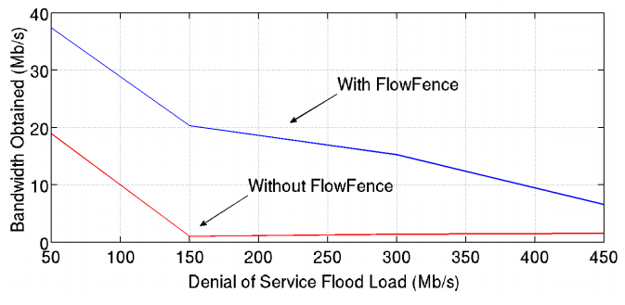
EXPERIMENTS
The first experiment measures the bandwidths received by a legitimate client during a flood attack, with and without the FlowFence defense, as a way of validating the prototype.

Slide 41
EXPERIMENTS
It is noteworthy that this result is not the same as the theoretical bandwidth that the client should receive according to proposed sharing algorithm.
It happens because the router still has to enqueue the incoming messages from both legitimate and malicious traffic.
Notes:
數據和想的不一樣
因為何不法合法的 message 都會 enququq

Slide 42
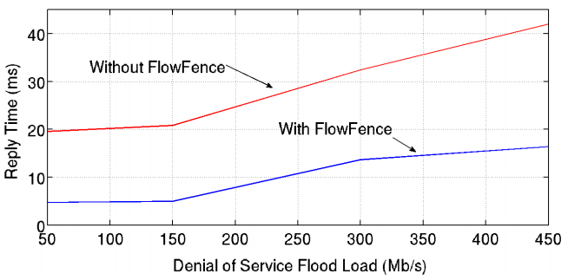
EXPERIMENTS
In the second experiment, Httperf was used to measure reply time for a legitimate client
The size of the requested content was of 1KB. The tool was configured to try 10 requests per second and to perform a total of 100 requests.

Slide 43
EXPERIMENTS
The last experiment measures FlowFence response time.
Response time is relevant because if a defense takes too long to detect and mitigate a lack of network resources, many legitimate transactions may fail.
This experiment deploys a scenario in which 9 attackers, generating a 450Mb/s load.
Notes:
FlowFence 的反應時間
如果 detect 和 response 的時間太長， legitimate user 的 transaction 會 fail.

Slide 44
EXPERIMENTS
In FlowFence, a Denial of Service condition is detected if the interface average-usage rate is higher than 80% [13].
To estimate the current interface usage, routers periodically capture samples of transmitted bytes per second and apply a sliding exponential window to estimate the interface average occupation.
The use of an exponential sliding window avoids false-positive alarms.

Slide 45
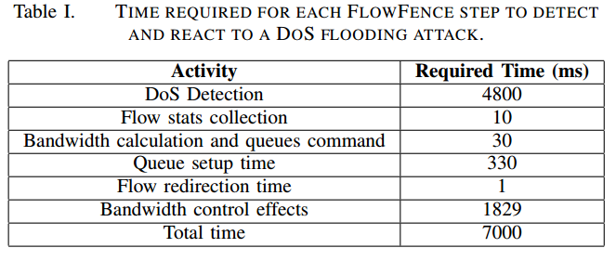
EXPERIMENTS

